Slide 1
ENSE 470, Milestone 4
Group Eh?
Nickolas Schmidt, Quinn Bast, Abdulaziz Alghamdi,
March 1st 2018

Slide 2
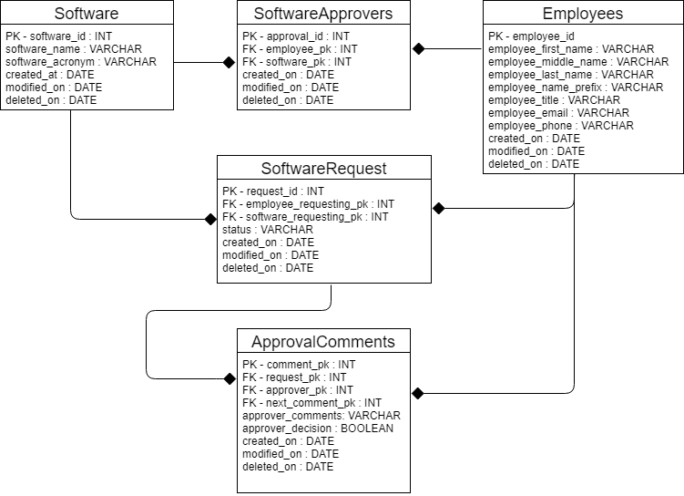
Database Snapshot

Slide 3
Database Information
Database:
MySQL database using PhpMyAdmin interface
3rd Normal Form to allow for future adaptations and changes
Employee table slightly complex – first, middle, last and prefix name fields
Data Cleansing:
Manually typing INSERTs are tedious. Thus:
Notepad++ find and replace with Regexs to easily create INSERT statements.
Linked software to approver with PHP instead of manually typing the INSERT.
Problems:
Assumed that the myeHealth software is different in each region

Slide 4
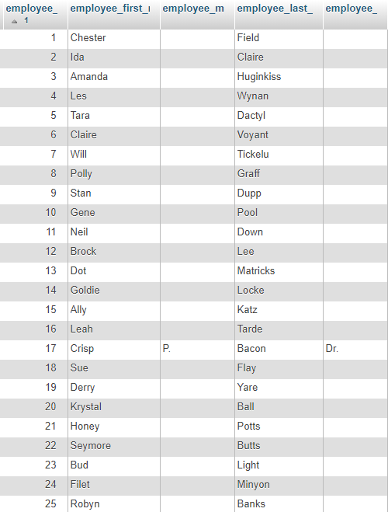
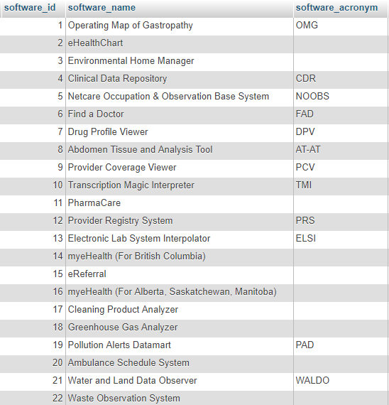
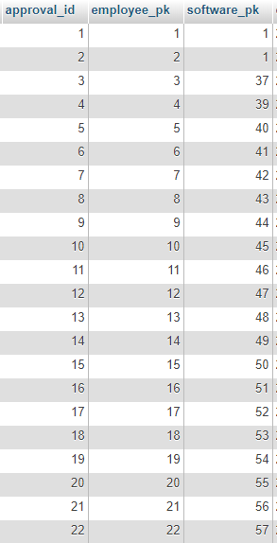
Software Approvers Table
Employee Table
Software Table

Slide 5
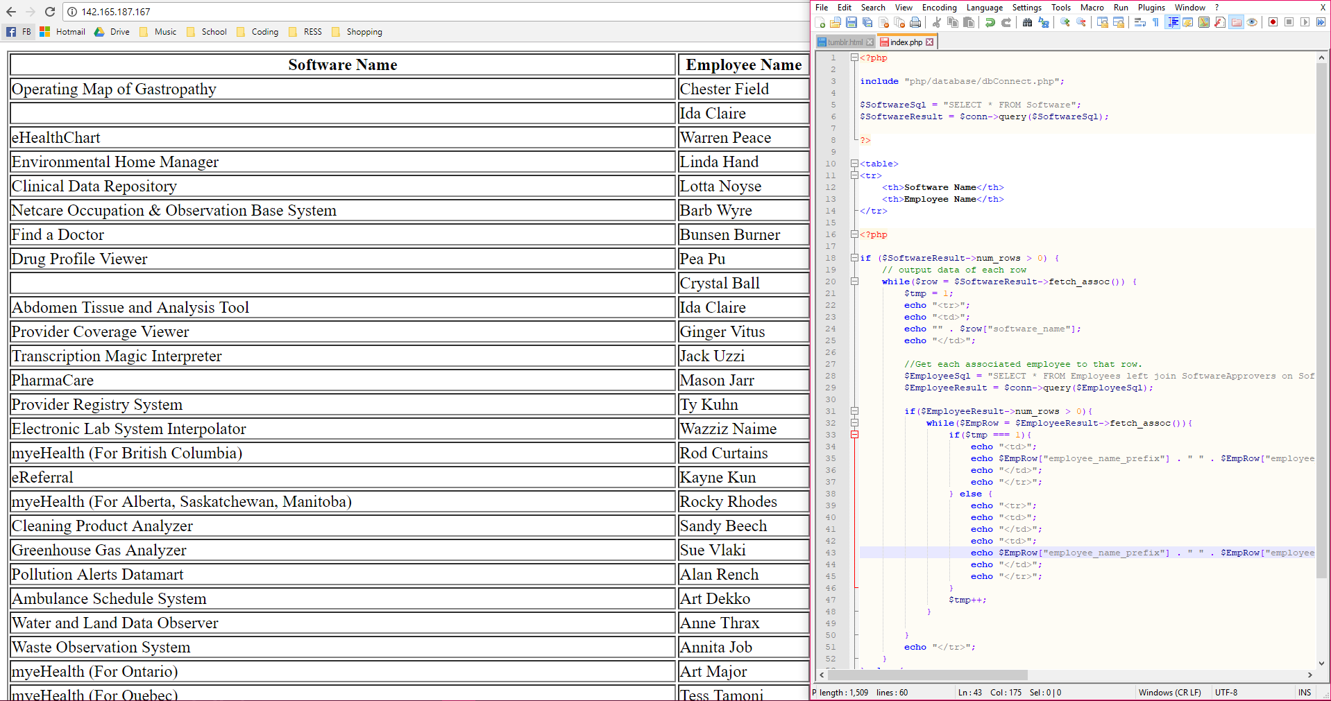
With some Php Magic: http://142.165.187.167/

Slide 6
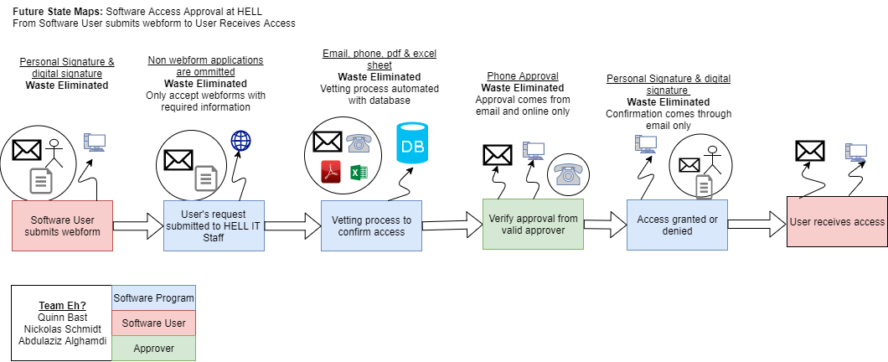
Recall, future state VSM

Slide 7
Low Fidelity Prototypes

Slide 8
Group reflection
How did you feel about this milestone? What did you like about it? What did you dislike?
What did you learn about yourself as you collaborated and worked through this milestone?
How will you use what you have learned going forward?
What “stuff & things” related to this milestone would you want help with?

